Slide 1
Procedural Content

Slide 2
What is it?
Benefits
Drawbacks
Demos

Slide 3
What is it?
Creating data with an algorithm, instead of manually
Algorithms can be any size, for any amount of data
What kind of data? Any kind!
Names, numbers
3D models
2D images
Terrain
Collision Geometry
Since EVERYTHING is just data…

Slide 4
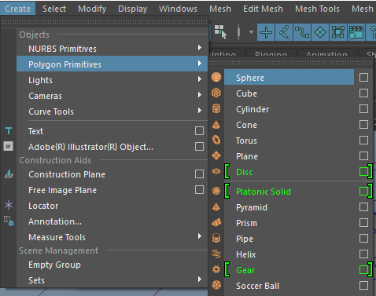
Simple generation
All content creation tools use some form of procedural generation
The vast majority of functionality in such a program may be procedural content generation
Creating a complex shape by hand? yuck
Each of these shapes is created by a “procedure” of some sort
LOTS of primitive shapes to start from in 3D

Slide 5
Simple data is easy
Create a triangle:
vertex[0] = (x, y, z);
vertex[1] = (x, y, z);
vertex[2] = (x, y, z);
Create a quad:
vertex[0] = (x, y, z);
vertex[1] = (x, y, z);
vertex[2] = (x, y, z);
vertex[3] = (x, y, z);

Slide 6
Simple data is easy
Create a row of quads:
for (i < desiredQuantity)
Create a quad:
offset = i * quadSize;
vertex[i + 0] = (x + offset, y, z);
vertex[i + 1] = (x + offset, y, z);
vertex[i + 2] = (x + offset, y, z);
vertex[i + 3] = (x + offset, y, z);
i += 4;
Doing the same thing LOTS of times often isn’t much more complicated than doing it once.*
*
USUALLY this is true… it could be quite difficult, frustratingly so!
Doing it once tends to be the hardest part.

Slide 7
More complex shapes… might not be that bad
Create curve:
// Where to start?
Break the shape down into components, establish some parameters (inputs) for the process
Small Radius
𝛳
Large
Radius
Angle plus a radius… what does that sound like?

Slide 8
More complex shapes… might not be that bad
Create curve:
For each segment of vertices
Generate XYZ value for “inner” and “outer” vertex
Increment angle, repeat for next set of points
Break the shape down into components
2. Create an algorithm to use those components (i.e. create a function to do the work)
Small Radius
StartX, StartY
x = StartX + cos(angle) * LargeRadius
y = StartY + sin(angle) * LargeRadius
Large Radius
x = StartX + cos(angle) * SmallRadius
y = StartY + sin(angle) * SmallRadius

Slide 9
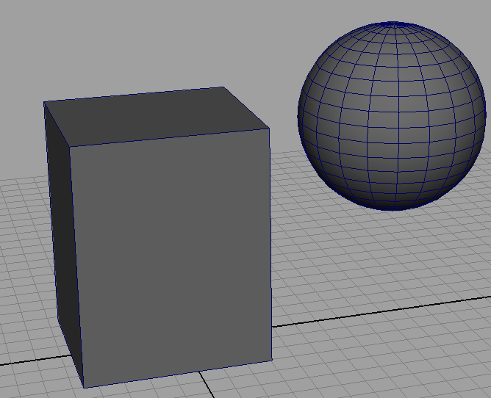
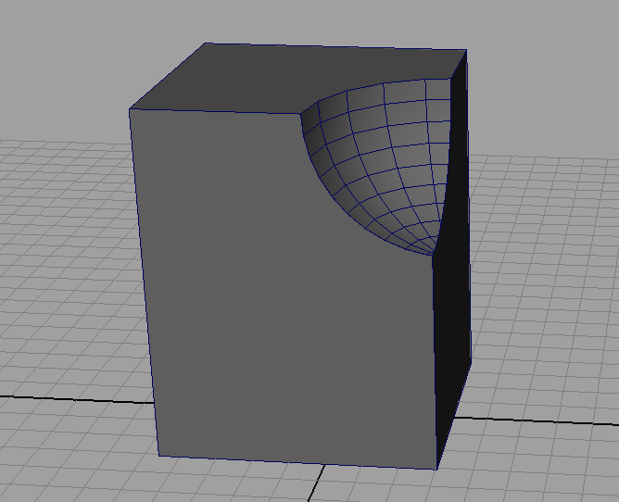
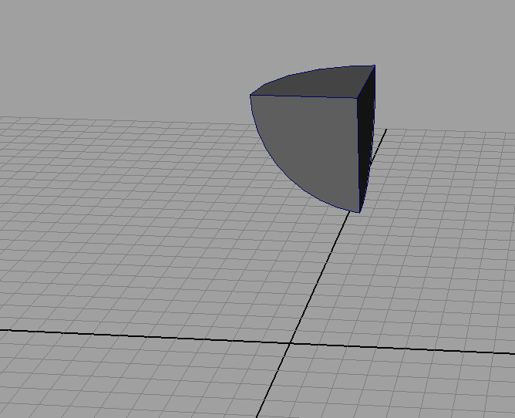
3D Models
Difference uses one mesh to cut out part of another
Intersection returns just the overlapping part
Boolean operations in 3D modeling software can combine objects in a variety of ways

Slide 10
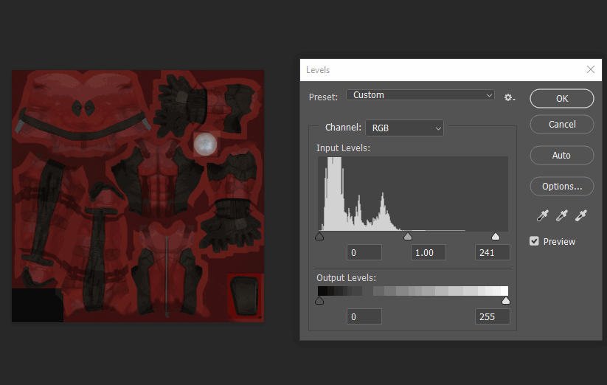
Photoshop tools
You COULD manipulate every pixel in the image by hand…
Manually adjusting the color of everything…
You probably wouldn’t make TOO many mistakes…

Slide 11
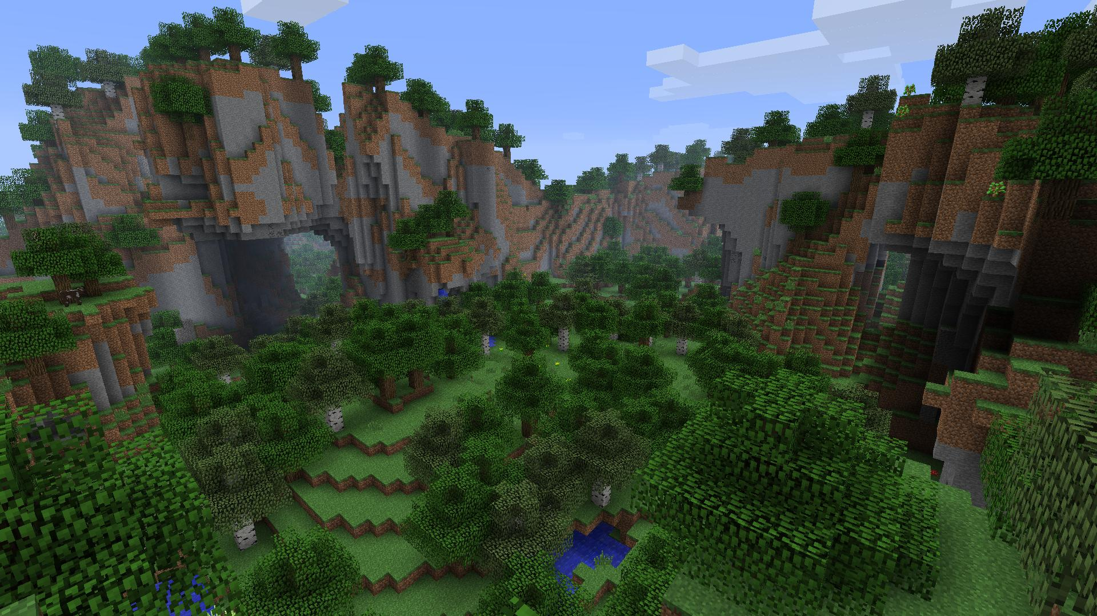
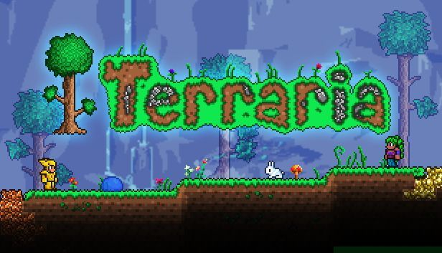
World generation (2D or 3D)
How many blocks are in a Minecraft world?
What about a Terraria map?
Up to 230,400,000,000,000,000 blocks
30,000,000 * 30,000,000 * 256
A large map has 20,160,000 tiles
8400 x 2400

Slide 12
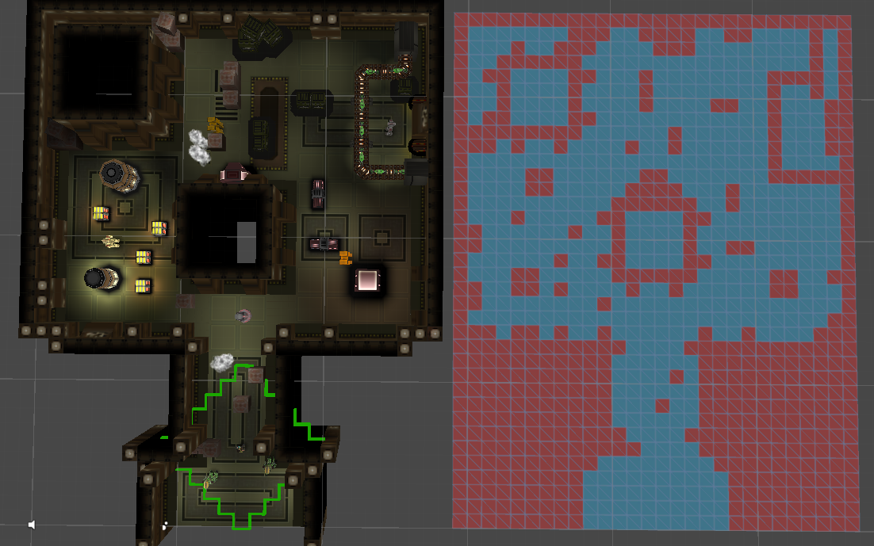
Game Boundaries
The blue/red grid defines where a character can and cannot stand
You COULD create that grid by hand… or create an algorithm to generate it, based on the environment
Change the environment? Just press a button to create (or RE-create) the grid
Game art vs game functionality

Slide 13
Name Generator
string[] firstNames
string[] lastNames
James
Mary
John
Karen
Donna
Andrew
Justin
Sam
Martin
Smith
Thompson
Garcia
Campbell
Johnson
Watson
Barnes
string fullName = firstNames[random() % 8] + " " + lastNames[random() % 8];
One line of code to generate 64 possibilities
“Procedural content” doesn’t have to be massive, or even visual

Slide 14
Procedural Generation – Benefits
Saves time
Don’t need to create from scratch, over and over again…
Variety
Generate 100 permutations in minutes (or seconds!)
Great for tedious, repetitive work
Frees up people to work on other, more interesting things
Can allow for “infinite” content (at least for practical purposes)
Replayability for games – avoid seeing the same content over and over again

Slide 15
Drawbacks
Hard to do
Requires a lot of setup
Data inputs – colors, height values
Rules – ranges, boundaries
Exceptional cases—can you even detect these?
Time-consuming to create, test, debug an algorithm
No guarantee of quality results

Slide 16
What if the algorithm fails?
Scenario: You need to build 5 levels/environments for a project
Each level takes 2 weeks to create
Using a complex formula: Time x Quantity = 10 weeks
An algorithm could build 5 levels in 5 minutes, but…
How long to develop that algorithm?
Hopefully it’s less than or equal to 10 weeks
If not… you have no procedure to generate content, and no content

Slide 17
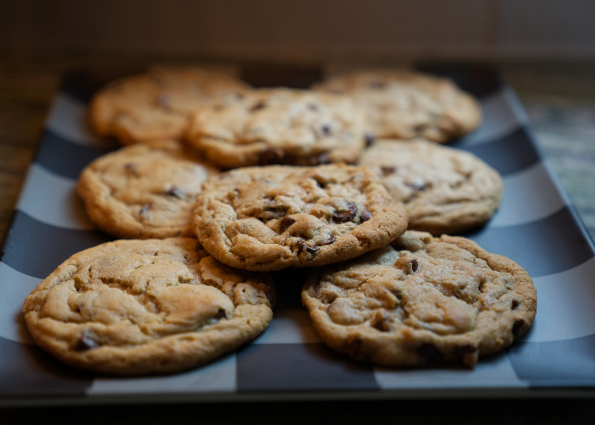
Real world Analogy
How long to make a batch of cookies?
How long to build a factory that makes cookies?
How much will it cost? (time, money, labor)
How much will THAT cost?

Slide 18
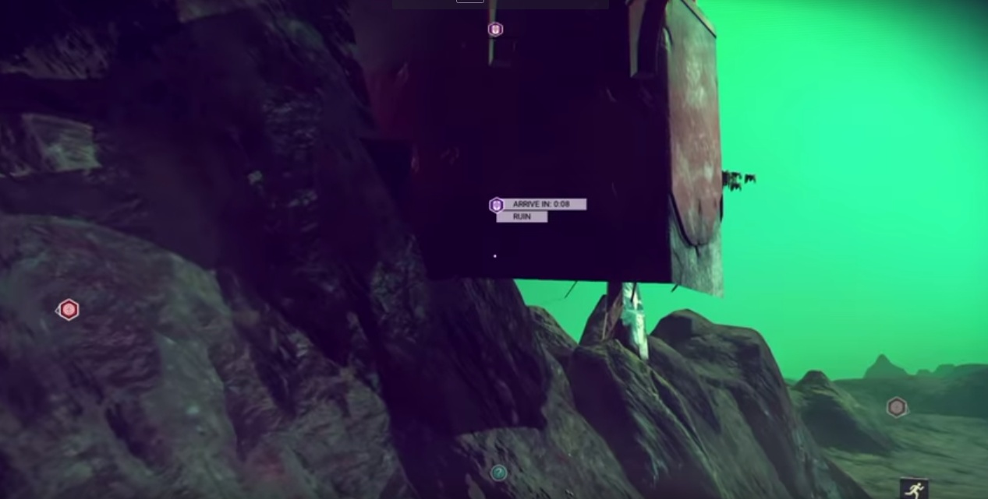
Easy to mess up
Maybe put a floor in there? Add some more hill? Some jutting rocks?

Slide 19
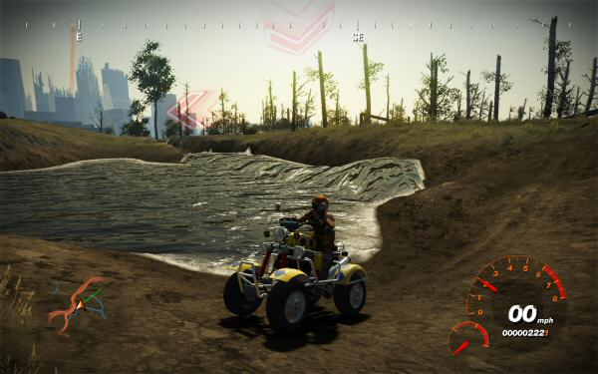
Easy to mess up
Water hills? Bad!
Flat water, good!

Slide 20
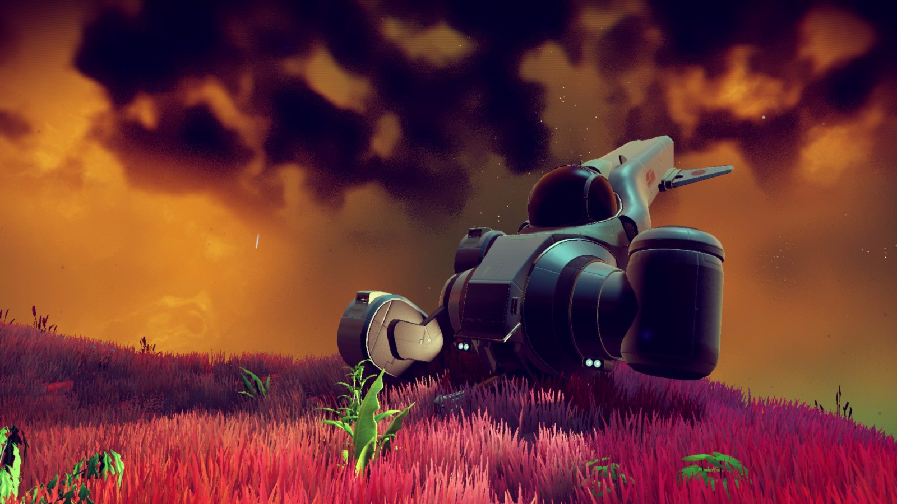
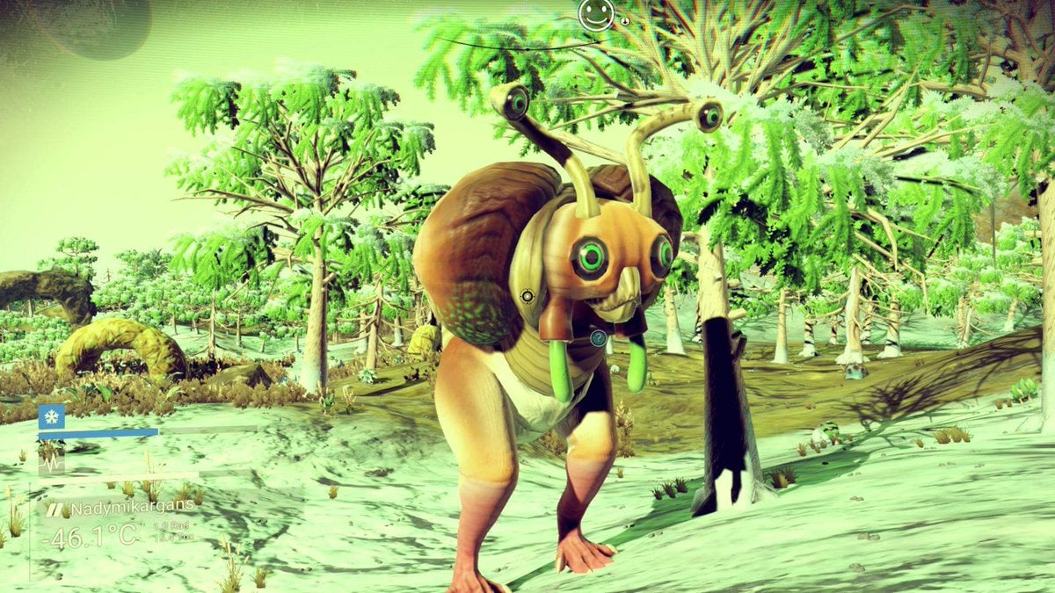
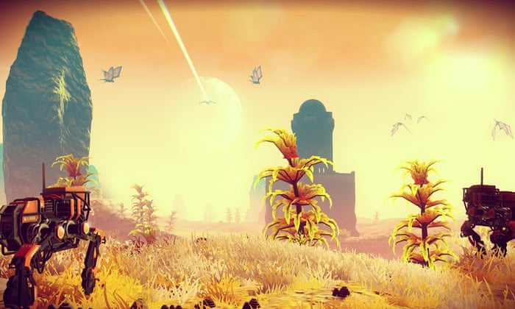
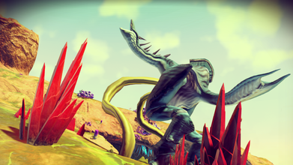
No Man’s sky
Allegedly has “18 quintillion planets”
Maximum value of an unsigned 64-bit number: 18,446,744,073,709,551,615
Are they all unique?
Are they all interesting?

Slide 21
Drawback – Is it interesting?
Or fun, stimulating, challenging, etc?
Computers don’t do “interesting” very well
More does not equal better
What about a hybrid approach?
A system to generate content…
…and a person to evaluate that content
Ultimately a human decides what is a “good” result
At least, for the time being… until the robots do that too!

Slide 22
Humans vs robots
Procedures are good for generating content, not so good at evaluating it
In the end, if humans will play/view/experience the content, a human should make some assessment of that content
At SOME point, at least…
But how to evaluate infinite content? Procedural evaluation? Hmm…
Hybrid approach – generate some number of variations, let a person pick the “best” one
Whatever best means – interesting/cool, hard, most colorful, fewest errors?
Use a procedure as a starting point, and adjust from there

Slide 23
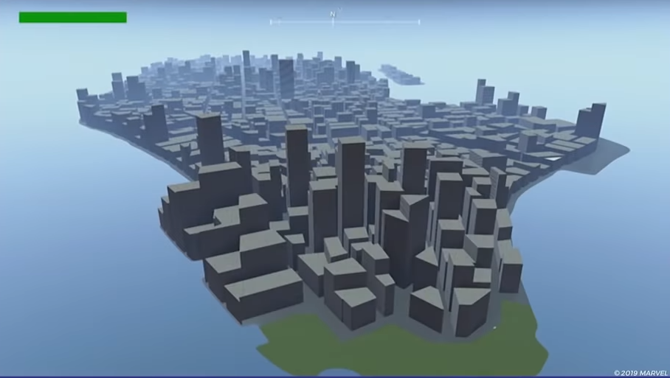
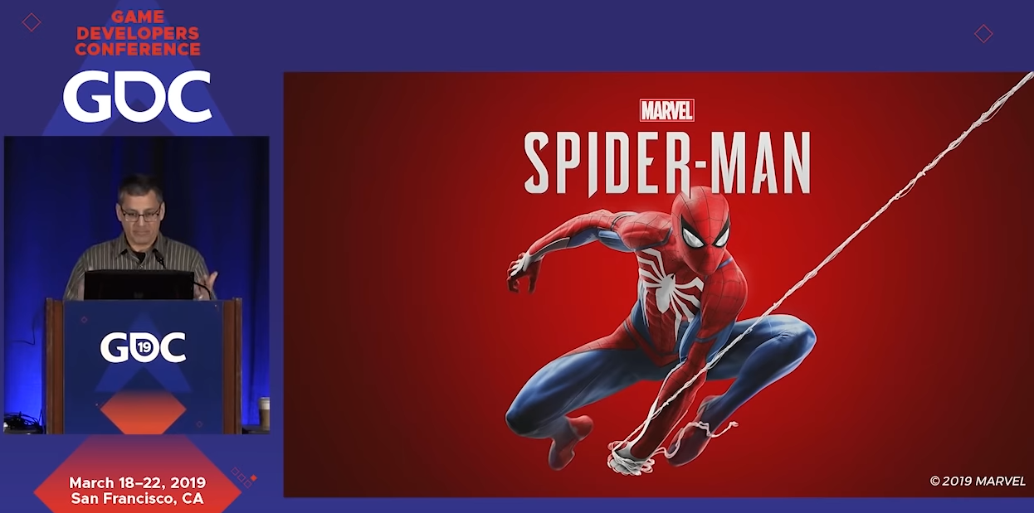
Spider-Man PS4
Procedural content to generate much of the “foundation” of the city – building, roads, etc
Target was “80% usable procedural content”
Hand-crafted content on top of that to refine and finalize – make it interesting/appealing
https://www.youtube.com/watch?v=4aw9uyj9MAE

Slide 24
Recap
Procedural content is a way to create content “automatically”
Short version: put some code into a function, then call that function later
You still have to write the code in the first place!
It can save time and effort, creating more for less
It can take many forms:
Real-time procedural content, create things as a program is running (Minecraft)
As an authoring tool—create content for someone to evaluate/refine (Spider-Man)
Results CAN be good, but may need adjustments
Depending on the task, may take longer than hand-crafting the thing (1 batch of cookies versus a factory)

